Slide 1
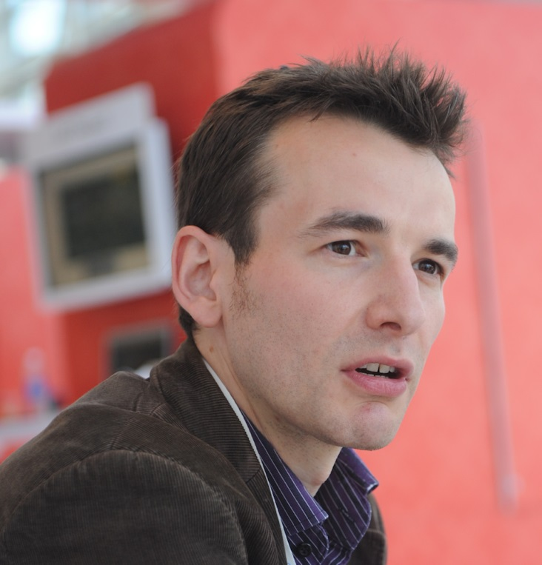
About me
Independent Consultant
(work mostly for Jisc CETIS)
http:/mashe.hawksey.info
@mhawksey

Slide 2
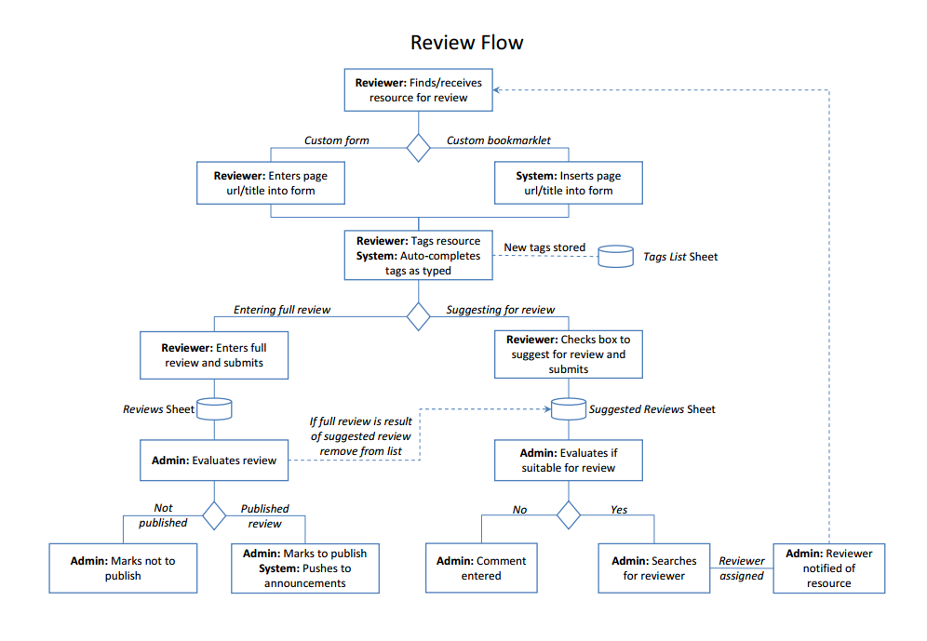
Community-led evaluation and dissemination of support resources https://sites.google.com/site/reviewsiteex/

Slide 3
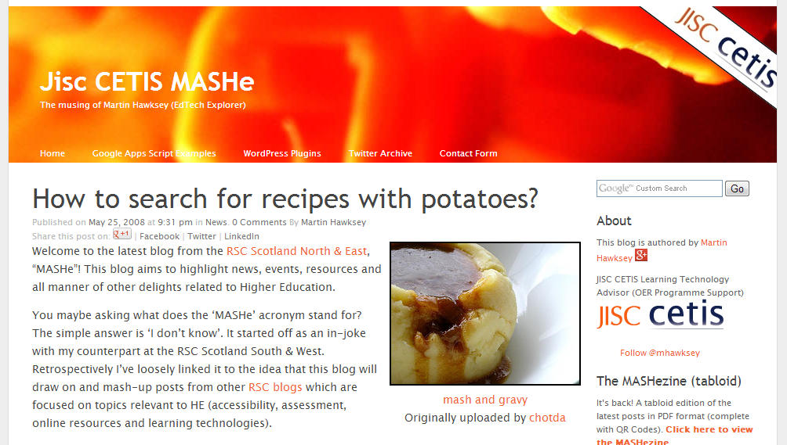
Resource description and discovery
Search for recipes containing potatoes
Or http://www.bbcgoodfood.com/recipes/1096/potatoes-dauphinoise

Slide 4
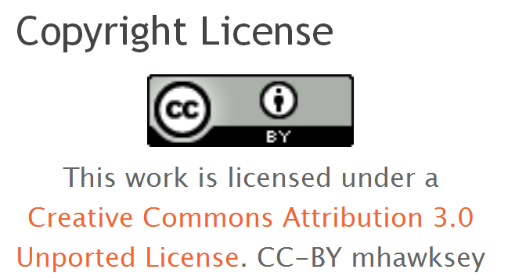
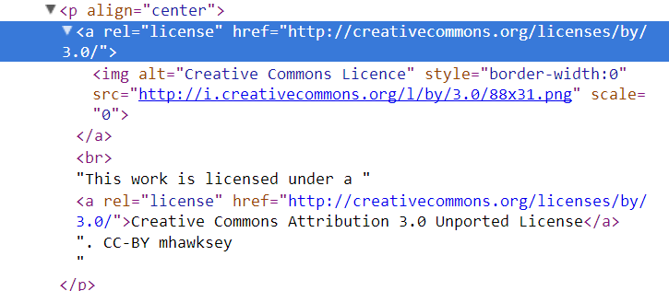
Micro Data

Slide 5

schema.org
"… improve the web by creating a structured data markup schema supported by major search engines. On-page markup helps search engines understand the information on web pages and provide richer search results." (schema.org, 2013)

Slide 6
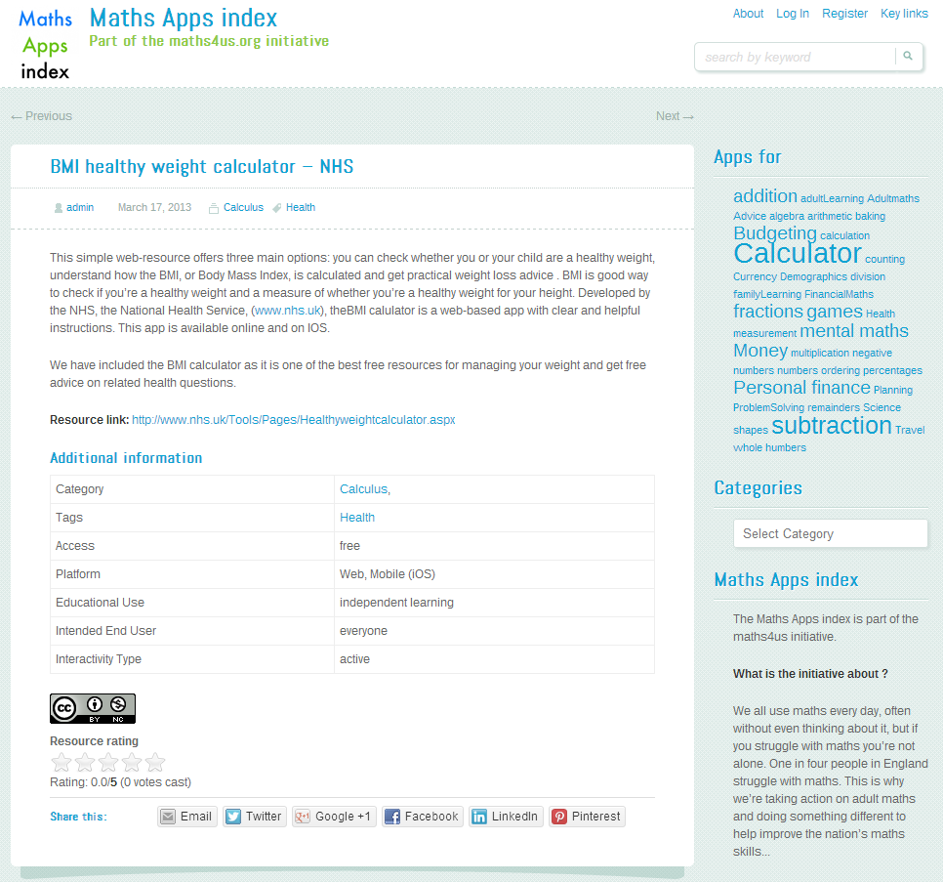
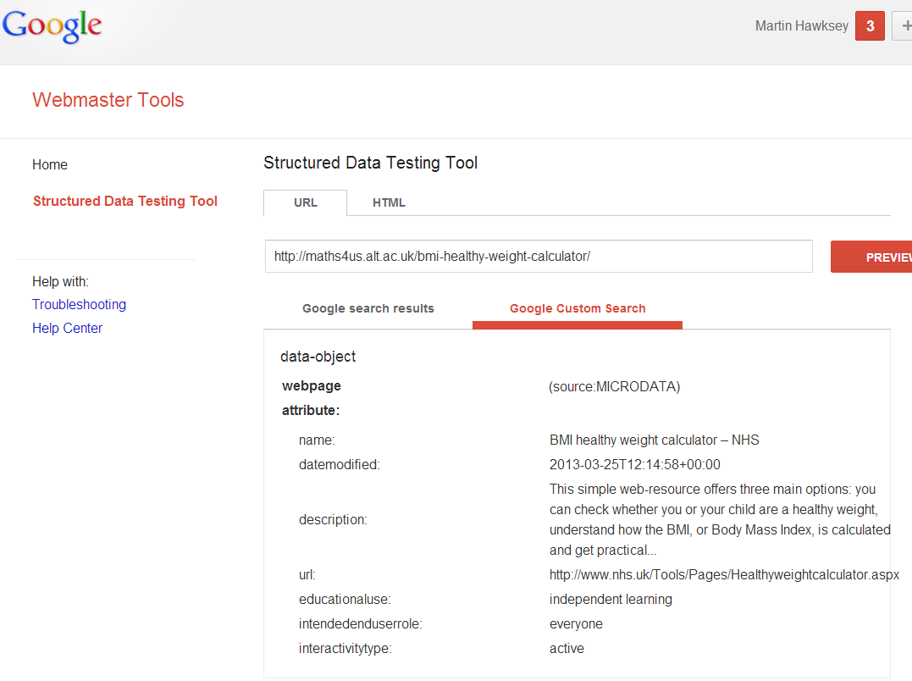
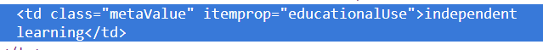

Slide 7
