Slide 1

Introducing the
Maths Apps index
Part of the
maths4us.org initiative

Slide 2
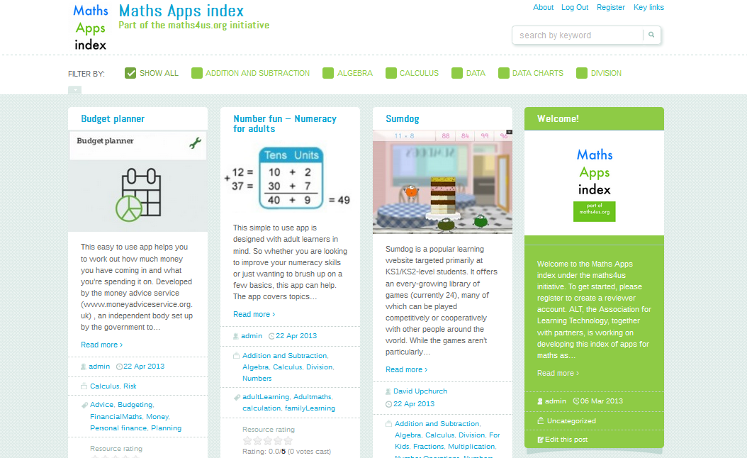

Slide 3
Maths4us initiative
Part of the maths4us initative;
Working in partnership with organisations and individuals to help improve maths skills for everyone;
For adult learners, teachers, tutors and everyone who wants to improve their maths and numeracy skills

Slide 4
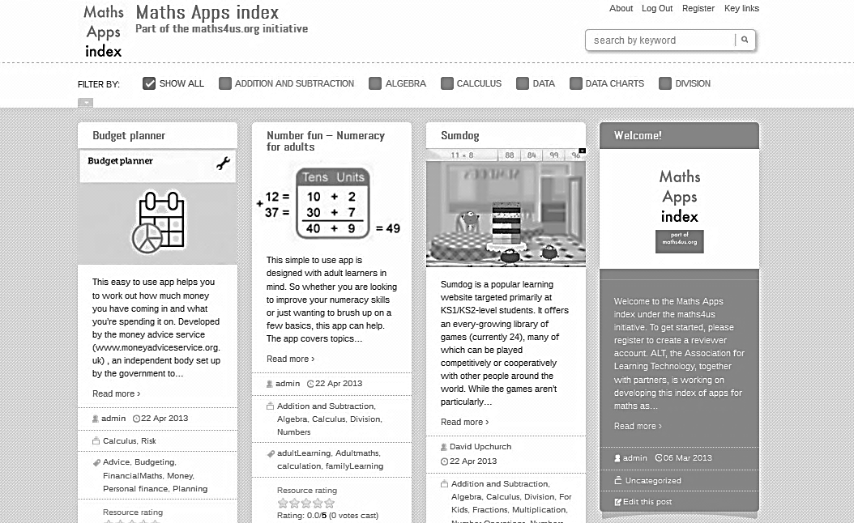

Slide 5
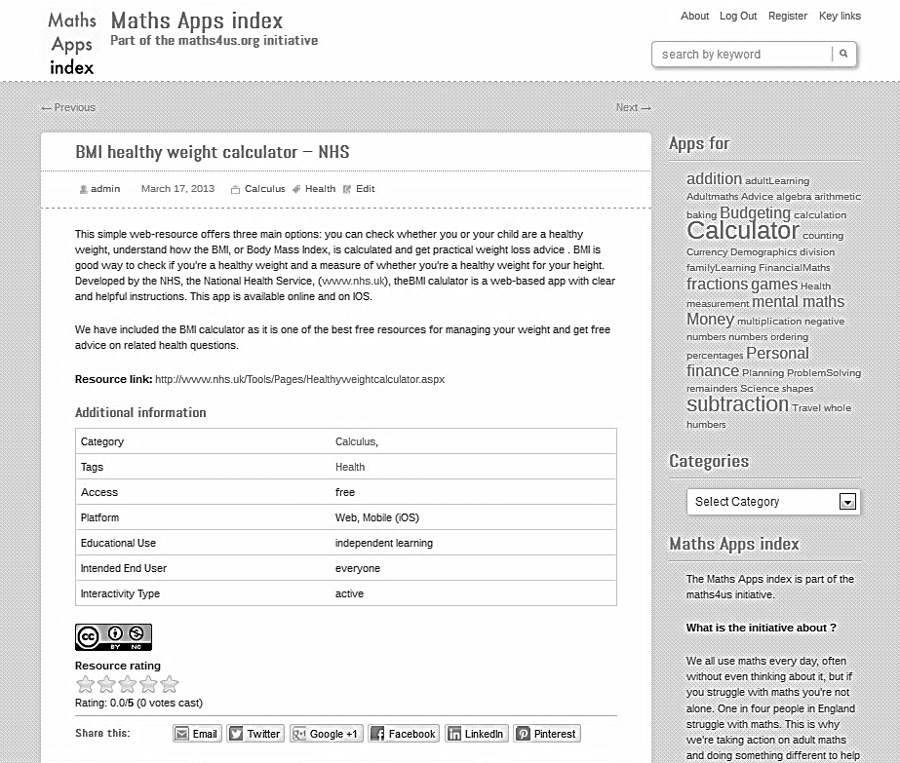

Slide 6
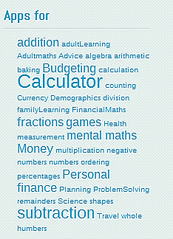
Everyday words taxonomy

Slide 7
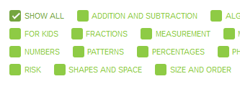
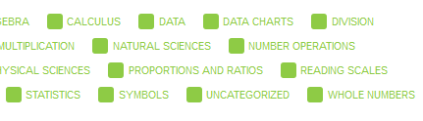
Maths-term taxonomy

Slide 8
Maths Apps index http://maths4us.alt.ac.uk
Part of the
maths4us.org initiative

