Slide 1



Staff development and learning technology - working with the new change agents
Clive Young and Stefanie Anyadi
University College London UK

Slide 2
Overview – 4 parts
The importance of teaching administrators (TAs)
JISC Digital Department project
Certified Membership of the Association for Learning Technology (CMALT) programme
UCL E-Learning Champions initiative

Slide 3
Part 1 The importance of teaching administrators

Slide 4
Context: UCL - London’s Global University
London’s first university - established 1826
Very strong research focus
One of top 10 global universities
Traditional campus-based teaching
24,000 students (40% postgrads)
4000 academic and research staff
80+ departments
Multidisciplinary
e-Learning ‘strategic’

Slide 5
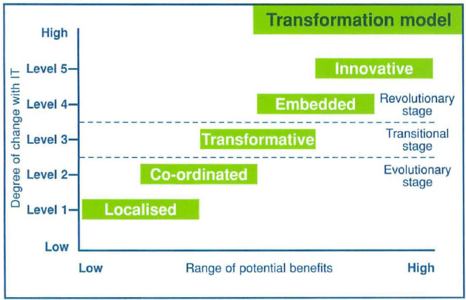
Context: ‘change’ in e-learning
MIT 90s transformational model
http://iltinfe.files.wordpress.com/2011/04/000897_managing_it-a_planning_tool_for_senior_managers.pdf

Slide 6
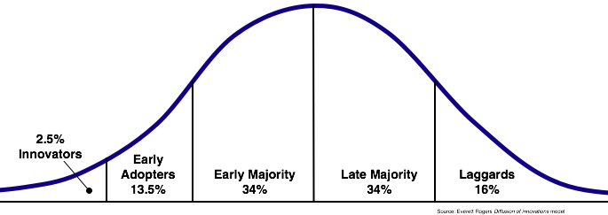



The human side of change – Rogers (1962)
http://www.flickr.com/photos/wfryer/1342355056/

Slide 7
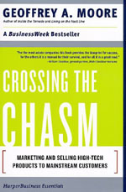
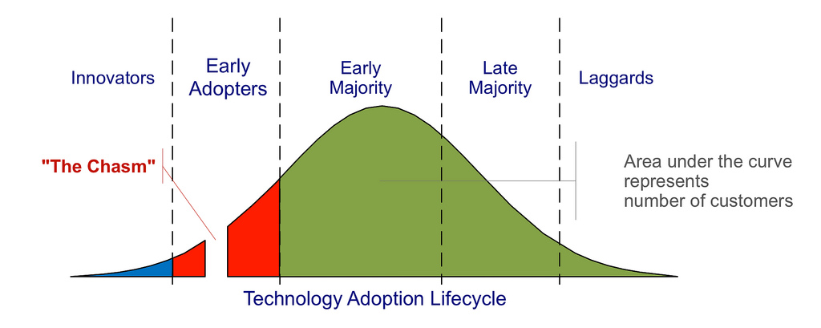
Crossing the chasm
http://www.flickr.com/photos/marketingfacts/4615037800/

Slide 8
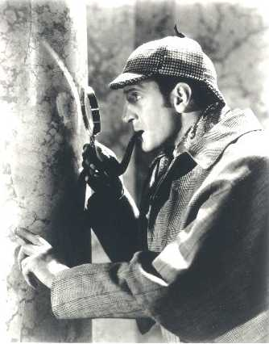
Did UCL cross the chasm in 2010?
‘Total Moodle’ campaign - compulsory
“The dog that didn’t bark”
Why?
UCL’s Teaching Administrators!

Slide 9
Who are teaching administrators at UCL?
c200 self-identified at UCL – The Forum
major contribution to the student experience – manage the digital presence
have a range of responsibilities
  admissions
  quality management
  programme and course coordination and planning
  VLE course management
  student communication and advice
  student feedback processes
  distance learning etc etc

Slide 10
Wider ‘professionalisation’
“ Not only are individuals interpreting their given roles more actively, but they are also moving laterally across boundaries, creating new institutional spaces, knowledges, and relationships, particularly in a ‘third space’ between professional and academic domains”.
Whitchurch 2008

Slide 11
Changing technologies, changing identities
“Academic and professional staff will all need to work together collaboratively and cooperatively.”
Graham, 2012
“Professional service staff contribute to student outcomes through using, and supporting student use of, changing technology”
Graham, 2012a
“changes in technology have driven wider change, not only in the way that work is completed, but also in the interactions that professional staff have with students and other staff, both professional and academic”
Graham 2012b

Slide 12
Pause
Do your departments have ‘Teaching Administrators’?

Slide 13
Part 2 the Digital Department

Slide 14


The Digital Department project
Professional profile and expertise of UCL teaching administrators (TAs)
Training programme
External accreditation via
Semi funded by Aug 2011 to 2013
Notes:
Investigate and benchmark

Slide 15
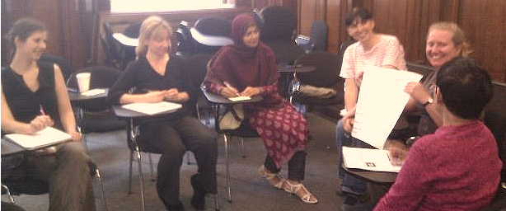
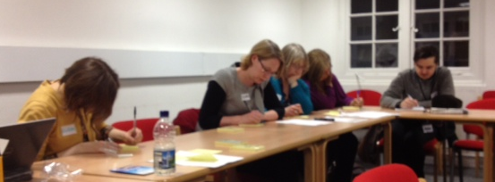
Started with a review of current practices
workshops
focus groups
surveys
training needs analysis (TNA)
case studies
student voice

Slide 16


Top 10 systems used by UCL TAs

Slide 17
Some of the tools UCL TAs use
40+ tools
UCL admin and financial systems
• Portico – student information service
• Financial Information System (FIS) - financial data and management
• Timetabling/CMIS - room bookings and timetabling
• Service in Partnership (SiP) – HR forms
• Rome - online recruitment
• Web content management (silva)
• Scanners – being piloted as attendance checks for Points-Based Immigration System (PBIS)
UCL teaching and learning systems
• Moodle - e–learning environment
• Turnitin – plagiarism detection
• Lecturecast – automated lecture recording
• Opinio - web-based surveys
• My Portfolio – staff and student e-portfolio
• Electronic Voting Systems (EVS) – audience response 'clickers'
• Wiki – collaborative web pages
• Blackboard Collaborate – virtual classroom
Communication and networking tools
• Email – inefficient way of contacting students?
• Facebook– seen mainly as a communication tool
• Phone Text messaging – no UCL service but a strong demand
• Messenger - text messaging
• Skype – video conferencing
• Linkedin – professional networking
• Blogs – UCLWordpress service
• Twitter –how to use in HE?
• YouTube – online videos
Productivity tools
• MS Office – Word, Excel, PP, Acrobat
• Dreamweaver – web page development
• Etherpad – collaborative note taking
• Evernote – stores notes, photos
• Google docs – share web documents
• Google analytics – web usage
• UCL Dropbox – exchange large files
• Dropbox – web-based online storage
Marketing and events management
• Eventbrite – events management
• Find a Masters – marketing
• Oxboffice – ticketing service
• Google Adwords – online advertising
“It is almost impossible for busy academic staff to stay up to date” (SLiDA)
Notes:
TA workshop – list of common tools; how compare with your list, any tools you use that are not on here? How many tools do you use?
Developments in technology make jobs complex
Increasing demands also from another source – student experience and importance of student feedback;
student unions and NUS also becoming more focused on student experience – NUS develop charters, focal points for local actions

Slide 18
Pause
Who looks after all this in your departments?
  Academics
  Administrators
  Postgrads
  Someone else?

Slide 19
Part 3 CMALT

Slide 20
Problem
How can we support staff to develop these digital literacies and practices?

Slide 21
Development
Training
Documentation (Handbooks, baselines)
Communities of practice
Certification
Integration

Slide 22
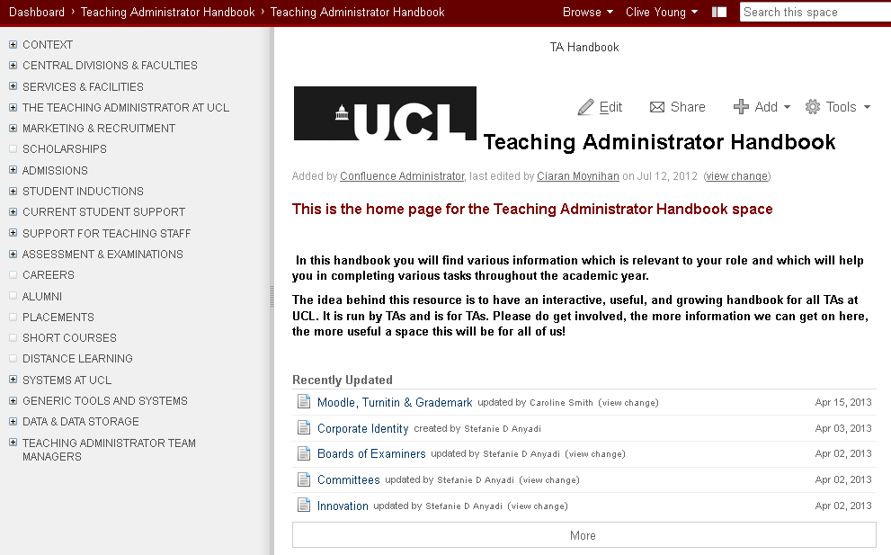
TA Handbook – shared knowledge

Slide 23
What is CMALT?
Portfolio providing external accreditation via
UCL training programme (Feb – July)
A chance to learn about, share and implement good practice in the wide range of technologies that support our students’ teaching and learning.

Slide 24
CMALT
A national peer-based professional accreditation scheme developed by the Association for Learning Technology
Reflective portfolio of c 3,000 words, demonstrating knowledge in four core areas
UCL programme of sessions over 6 months supporting each section of the portfolio
Groups and mentors

Slide 25
UCL CMALT Programme Structure
Monthly workshop sessions covering each section of the portfolio
Getting Started - Feb
Operational Issues and Technical Knowledge - March
Teaching, Learning and Assessment Processes - April
The Wider Context - May
Communication and Working with Others - June
Specialist Topic presentations by CMALT participants - July
Presentations
Group discussions with mentor
Time to write up notes

Slide 26
Three cohorts 2012-2014
It takes about six months from start to submission and it takes around 25-35 hours in all to complete including around 15 hours contact time.
68 have now participated, 46 completed
  TA and academic colleagues (UCL E-Learning Champions)
  Support staff
  IoE colleagues
26 submissions, 17 passed (8 referrals)

Slide 27
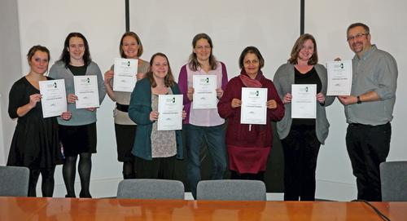
First success!

Slide 28
Constructing responses
Description
What you did
Write in first person
Reflection
What it meant
What you learnt
How you might do it differently
Evidence
Certificates
Reports
Screen shots
Links to online material

Slide 29
Part 4 E-learning Champions

Slide 30

UCL Champions
For each department/division
Academic champion
Admin/support champion
130 Champions
Links to UCL Teaching Administrators Forum (200 members) and CMALT (E-learning certification)

Slide 31
The role of the champions
Build a network of departmental e-learning champions
Develop departmental e-learning statements highlighting support needs.
  Work with ELE and CALT to support development.
  Measure and review departmental e-learning provision periodically, feeding back into departmental and central quality frameworks.
Identify and help disseminate good local, UCL and sector-wide practice, and support local events and networks.

Slide 32
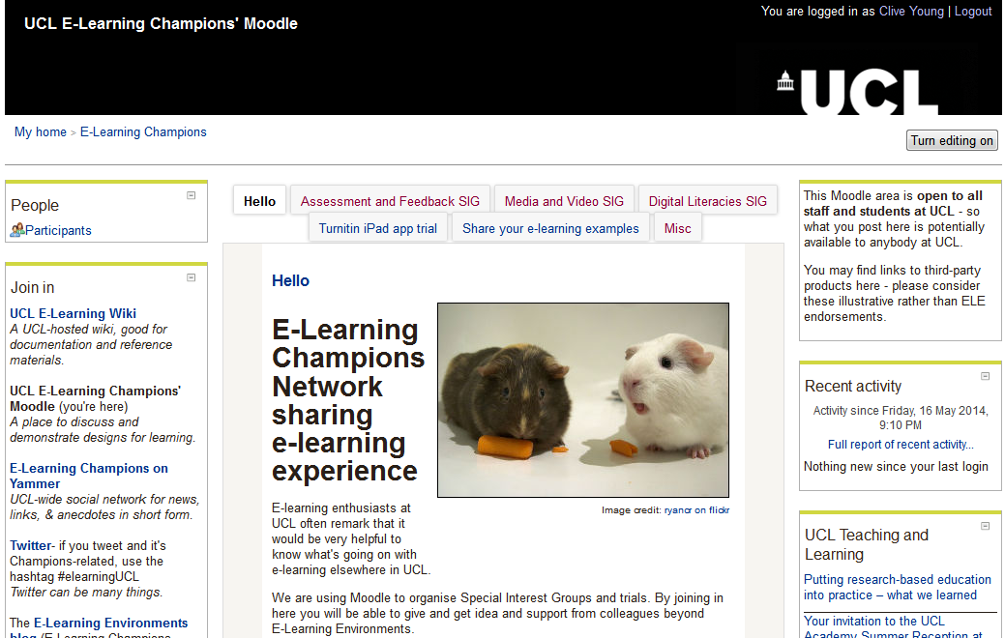

Slide 33
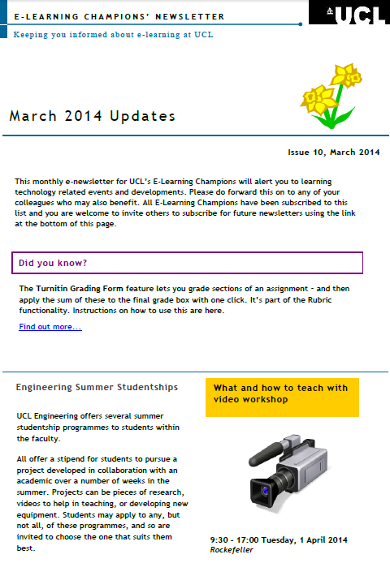
Newsletters

Slide 34
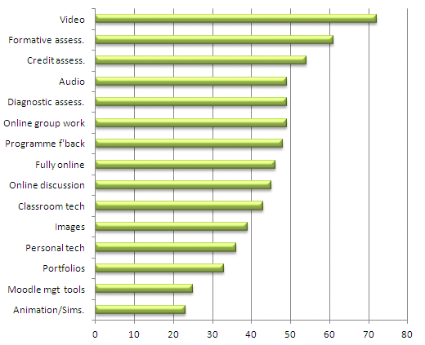
Priorities -> Projects

Slide 35
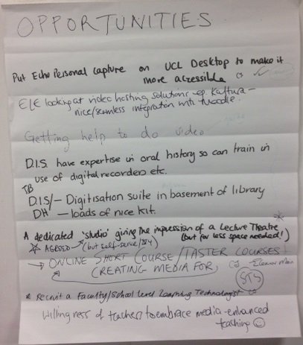
Special Interest Groups (SIGs)
Assessment and Feedback (next...Turnitin)
Media and Video (next ... July 10 Video ‘Masterclass’)
Digital literacies - survey
Others?

Slide 36
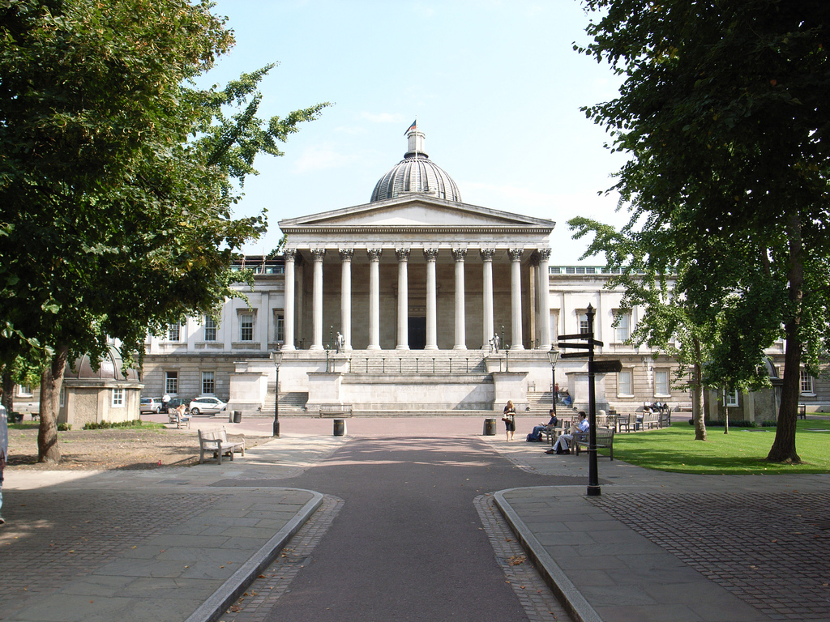
Why is it important to UCL?
http://www.flickr.com/photos/stevecadman/246302724

Slide 37
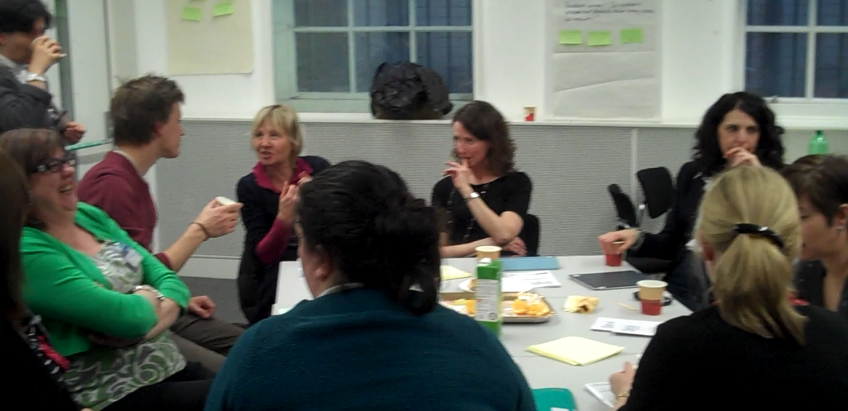
Network of ‘change agents’
Self- identified group
200+ individuals across the whole campus
Community of practice
Close support for our academics
Support change e.g. Moodle 2
Committed to improvement
Information source

Slide 38
Helping to bridge the chasm by support

Slide 39
A driver for transformative change
MIT 90s transformational model
http://iltinfe.files.wordpress.com/2011/04/000897_managing_it-a_planning_tool_for_senior_managers.pdf

Slide 40
Some lessons
  Identify, actively network and develop professional staff supporting teaching and learning locally and publicly acknowledge their value to the overall mission, including them in strategic and local planning.
  Actively encourage and support collaboration between professional staff based in departments and those based in central divisions and the collaboration between academic/teaching staff, professional staff and students.
  Research actual use: workflows, practices, policies, roles (academic and support staff), standard operating procedures etc.

Slide 41
Beyond UCL
Not really about ‘teaching administrators’
May be academics / teaching assistants / postgraduate students etc
Roles usually hybrid
Staff development for strategic change?
What training / support? CMALT?
Networking
Ownership

Slide 42
Questions?

